Slide 1
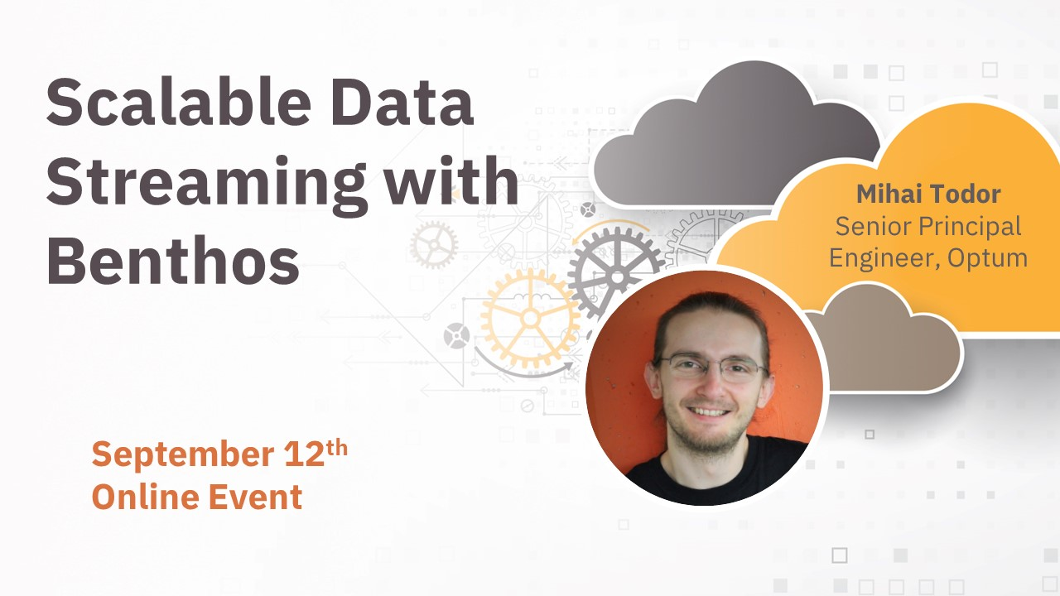

Slide 2
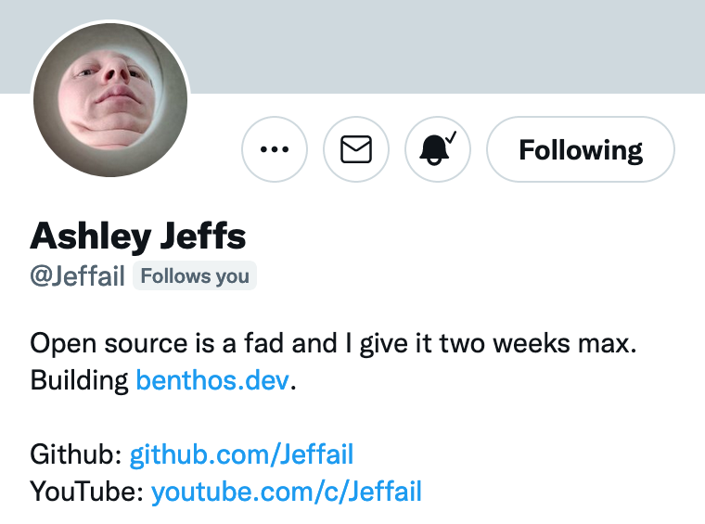
Disclaimers
Thoughts expressed here are my own
Benthos is owned and maintained by Ash: twitter.com/Jeffail
Ash designed and built Benthos from scratch
I am a contributor to the project

Slide 3

What is Benthos? benthos.dev
Hint: It has nothing to do with deep sea fish, except for the logo

Slide 4
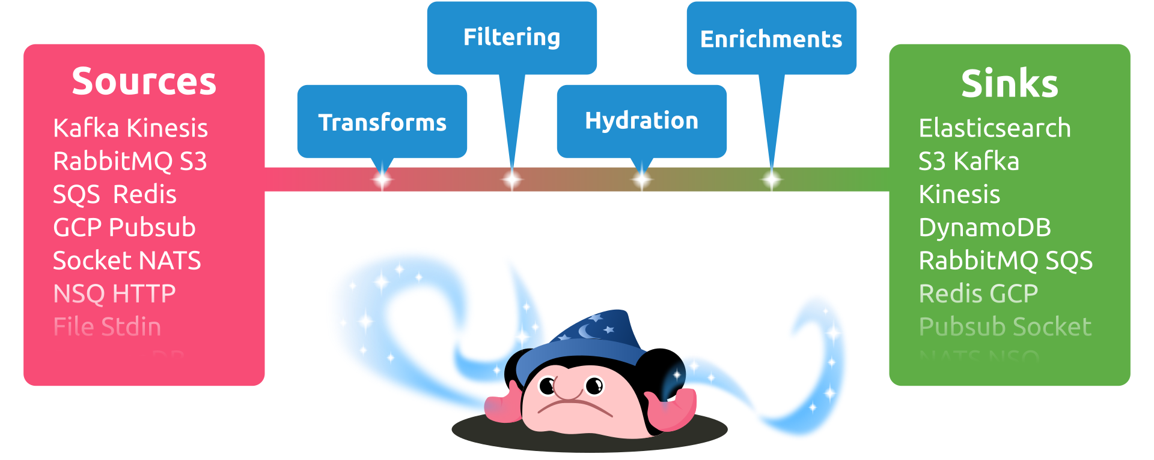
What is Benthos for?
„Fancy stream processing made operationally mundane” - Ash Jeffs

Slide 5

Boringly easy to use
# Install
curl -Lsf https://sh.benthos.dev | bash
# Make a config
benthos create stdin//stdout > ./config.yaml
# Run
benthos -c ./config.yaml

Slide 6

Features
Declarative YAML-based configuration
Single message transforms
At least once delivery
Metrics and logging
Custom Plugins
Written in Go

Slide 7

Bloblang
root.new_doc = match this.doc {
this.type == "article" => this.article
this.type == "comment" => this.comment
_ => this
}
Custom DSL for arbitrary data transforms
{
"doc": {
"type": "article",
"article": {
"id": "foo",
"content": "qux"
}
}
}
{
"new_doc": {
"id": "foo",
"content": "qux"
}
}

Slide 8


Deployment models
Standalone CLI app
Serverless
Kubernetes

Slide 9

Importing Benthos as a library
> go get github.com/benthosdev/benthos/v4
package main
import (
"context"
"github.com/benthosdev/benthos/v4/public/service"
// Import all standard Benthos components
_ "github.com/benthosdev/benthos/v4/public/components/all"
)
func main() {
service.RunCLI(context.Background())
}

Slide 10
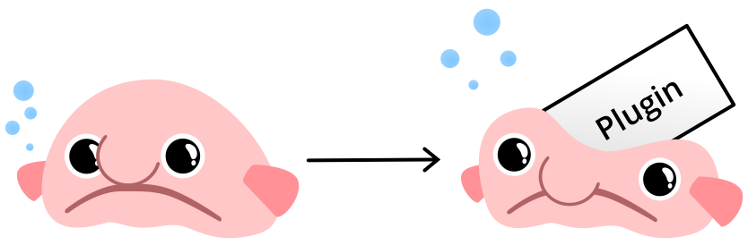
Benthos with sentiment analysis support
Adds a new sentiment() Bloblang method
Implementation here: github.com/mihaitodor/benthos-vader

Slide 11
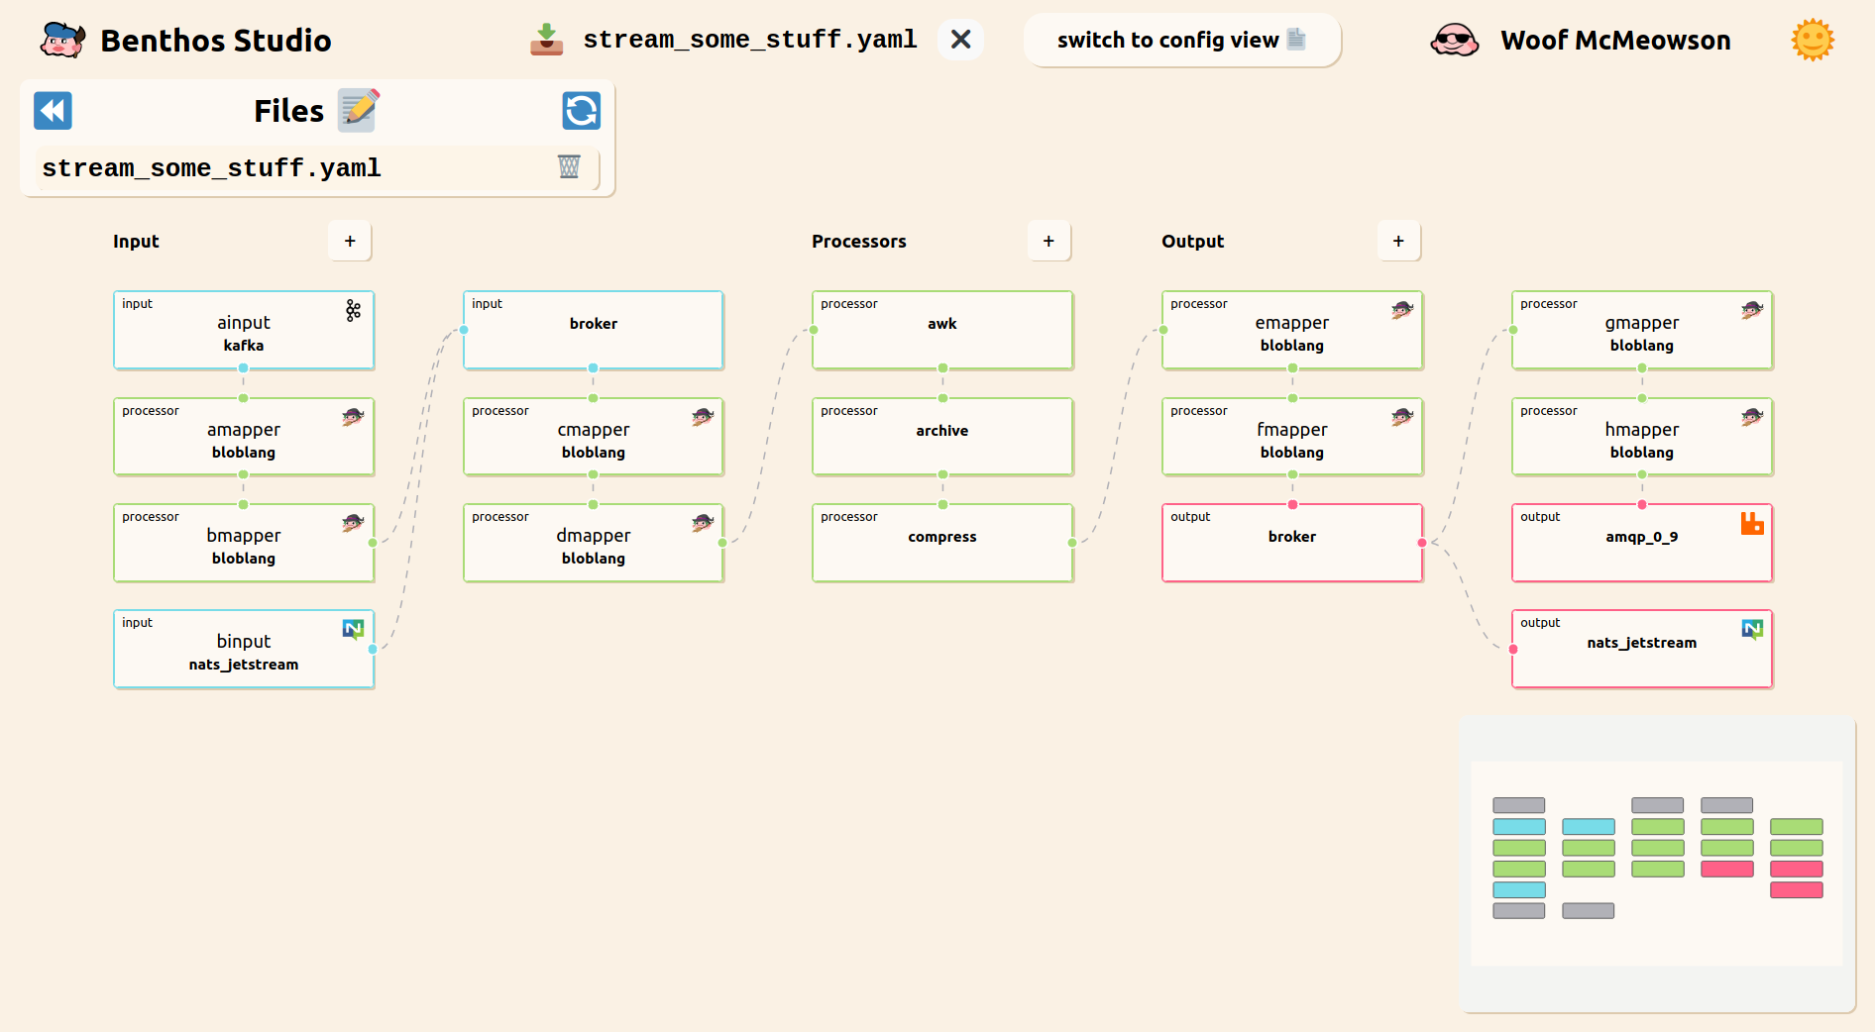
Benthos Studio

Slide 12
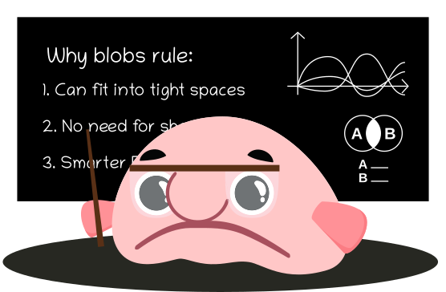
Why Open Source?
Built on the shoulders of giants
Community-driven features, enhancements and bug fixes
High quality standards enforced uniformly
Open issue tracker and permanent change history
Avoids vendor-driven lock-in

Slide 13

Open Source Needs You!

Slide 14


Future enhancements and goodies
More adapters
Custom plugins
Benthos Studio

Slide 15

More resources
My KnativeCon talk: youtube.com/watch?v=3OaRXwcRJJk
Ash’s YouTube channel: youtube.com/c/Jeffail
Support page: benthos.dev/support

Slide 16



Community benthos.dev/community
discord.gg/6VaWjzP
invite.slack.golangbridge.org
#benthos channel

Slide 17




Thank you!
linkedin.com/in/mtodor/
twitter.com/MihaiTodor
github.com/mihaitodor

